Slide 1
Statistical Learning Introduction to Statistics

Slide 2
Outline
1. Why Statistics
2. Statistical Methods
3. Types of Statistics - Descriptive and Inferential Statistics
4. Types of Datasets

Slide 3
Applied Statistics
Applied statistics is the root of data analysis.
The practice of applied statistics involves analyzing data to help define and determine business needs.
Modern workplaces are overwhelmed with big data and are looking for statisticians, data analysts, data scientists, and other professionals with applied statistics knowledge who can organize, analyze, and use data to solve real-world problems.

Slide 4
Applied Statistics
In fact, studies show that companies employing data-driven marketing strategies are seeing up to 20% increases in revenue and 30% decreases in spending.
Government agencies, non profits, and other organizations can use data to help prevent disease, collect important demographic information, steer political campaigns, and test potential life-saving pharmaceutical products.
As business leaders grow their understanding of the power of data for their companies, the exponential demand for statisticians and other professionals with advanced applied statistics skills will only continue to increase.

Slide 5
Applications
The friend recommendations you see on Facebook and the product suggestions that pop up on Amazon?
Those are all generated using applied statistics. Google once used applied statistics to predict flu outbreaks based on search data
Statistician Nate Silver analyzed data to come up with his election forecasts
Netflix and Hulu analysts use viewership data to create algorithms that generate recommended content.
From engineering to entertainment, applied statistics show up strong.

Slide 6
What Are Career Opportunities for Applied Statistics?
A wide variety of professional opportunities exist for students with applied statistics master’s degrees.
The following list is just a selection of the many career paths available:
Business
Statistician
Data Scientist
Data Analyst
Engineering
Quality Engineer
Manufacturing Engineer
Statistical Engineer
Validation Engineer
Finance and Accounting
Risk Analyst
Financial Analyst
Quantitative Analyst
Actuarial Director
Financial Crimes Analyst
Compliance Officer
Data Architect

Slide 7
What Are Career Opportunities for Applied Statistics?
Information Technology
Machine Learning Researcher
Intelligent Automation Technology Associate
Statistical Programmer
Marketing
Marketing Analyst
Business Analyst
Marketing Research Manager
Medical and Health
Biostatistician
Clinical Informatics
Health Research Analyst
Statistical Scientist
Science and Research & Development
Modeler
Cognitive AI Data Scientist

Slide 8
Why Are People with Applied Statistics Degrees in Such High Demand?
Take a look at the U.S. News & World Report rankings for applied statistics careers:
Data Scientist: #2 in Best Technology Jobs, #6 in Best STEM (Science, Technology, Engineering , Management) Jobs, and #8 in 100 Best Jobs overall.
Statistician: #2 in Best Business Jobs, #5 in Best STEM Jobs, and #6 in 100 Best Jobs
Operations Research Analyst: #5 in Best Business Jobs, #13 in Best STEM Jobs, #30 in 100 Best Jobs
Computer Systems Analyst: #5 in Best Technology Jobs, #15 in Best STEM Jobs, #47 in 100 Best Jobs

Slide 9
Why Statistics is So Important?
Three significant events triggered the current meteoric growth in the
use of analytical decision making and Statistics is central to all of them.
Event1
• Technological developments, Revolution of Internet and social networks, data generated from mobile phones and other electronic devices, produce large amount of data from which insights will have to be sifted.
• The discovery of pattern and trends from these data for organizations will pave the way for improving profitability, understanding customer expectations, and appropriately pricing their products so that they can gain competitive advantage in the marketplace.

Slide 10
Why Statistics is So Important?
Event 2
• Advances in enormous computing power to effectively process and analyze massive amounts of data
• Sophisticated and faster algorithms for solving problems
• Data Visualization for Business Intelligence and Artificial Intelligence

Slide 11
Why Statistics is So Important?
Event 3
• Large data storage capability
•Parallel computing, and cloud computing coupled with better computer hardware have enabled businesses and other organizations to solve large scale problems faster than ever before without sacrificing

Slide 12
Big Data
Big data
A set of data that cannot be managed, processed, or
analyzed with traditional software/algorithms within a reasonable amount of time.
• Big data revolves around Volume Velocity Variety Value Veracity
Walmart handles over one million purchase transactions per hour.
Facebook processes more than 250 million picture uploads per day.

Slide 13
Statistics - Methods
Classification
• Classification techniques helps in segmenting the customers into appropriate groups based on key characteristics.
• For example, using appropriate statistical model, an organization could easily segment the customers into Long Term Customers, Medium Term Customers, and Brand Switchers.
Brand switching is the opposite of brand loyalty. It means that clients stop buying from a company and choose another brand with similar products.
Brand loyalty is the positive association consumers attach to a particular product or brand. Customers who exhibit brand loyalty are devoted to a product or service, which is demonstrated by their repeat purchases despite competitors' efforts to lure them away.
• Another application in this context is classifying customers into “Buyers and Non-Buyers.”
• Classification helps professionals understand the customer behavior and position their products and brands using appropriate strategies.

Slide 14
Statistics - Methods
Pattern Recognition
• “A picture is worth thousand words” and it reveals hidden pattern in the data that could be leveraged by retail professionals. Pattern recognition techniques include Histogram, Box Plot, Scatter Plot and other Visual Analytics.
• For example, histogram drawn for income of a particular class of customers may reveal a symmetrical bell curve pattern or may be left or right skewed.
• Relationship between age and expenditure could be captured using a scatter plot.
• Box Plot enables identification of outliers (extreme points) apart from providing the distribution pattern.

Slide 15
Statistics - Methods
Association
• Association Analysis helps in determining which of the items go together. Association rules include a set of analytics that focuses on discovering relationships that exist among specific objects.
• In this context, market basket analysis refers to an association rule that generates the probability for an outcome.
Market basket analysis is a data mining technique used by retailers to increase sales by better understanding customer purchasing patterns. It involves analyzing large data sets, such as purchase history, to reveal product groupings, as well as products that are likely to be purchased together.
• For example, market basket analysis may lead to a finding that if customers buy coffee, there is a 40% probability that they also buy bread.

Slide 16
Statistics - Methods
Predictive Modeling
• Both customer segmentation as well as identifying and targeting most profitable customers can be facilitated by predictive models.
• Regression can be used for predicting the amount of expenditure on a particular product based on input variables income, age, and gender.
• Organizations can leverage on other advanced models that comprise Logistic Regression, and Neural Networks for predicting a target variable as well as classifying and predicting into which group the consumer belongs to.
• For example, these models can classify and predict buyers and non-buyers, and defaulters and non-defaulters on credit card loan.

Slide 17
Types of Statistics
Descriptive Statistics is concerned with Data Summarization, Graphs/Charts, and Tables
Inferential Statistics is a method used to talk about a Population Parameter from a Sample

Slide 18
Population, Sample, Statistic
A Population is the universe of possible data for a specified object. Example: People who have visited or will visit a website.
A Sample is a selection of observations from a population.
Example: People (or IP addresses) who visited a website on a specific day.
A Statistic is a numerical value associated with an observed sample. Example: The average amount of time people spent on a website on a specific day.

Slide 19
Outline
• Measures of Central tendency: Mean, Mode, Median
Histograms
• Measures of Dispersion: Range, IQR, Variance, Standard deviation
• Normal distribution
• Five number summary, Boxplots.

Slide 20
Frequency Distribution
In simple terms, frequency distribution is a summarized table in which raw data are arranged into classes and frequencies.
Frequency distribution focuses on classifying raw data into information. It is a widely used data reduction technique in descriptive statistics.

Slide 21
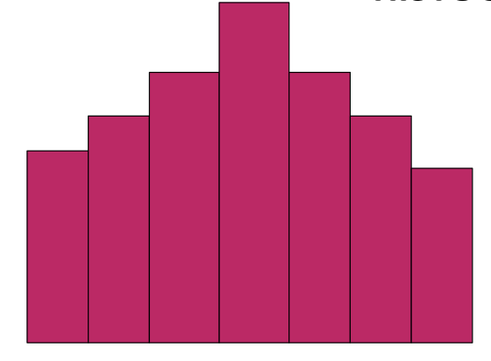
Histogram
Histogram (also known as frequency histogram) is a snap shot of the frequency distribution.
Histogram is a graphical representation of the frequency distribution in which the X-axis represents the classes and the Y-axis represents the frequencies in bars Histogram depicts the pattern of the distribution emerging from the characteristic being measured.

Slide 22
Histogram
Here's How to Calculate the Number of Bins and the Bin Width for a Histogram
Count the number of data points.
Calculate the number of bins by taking the square root of the number of data points and round up.
Calculate the bin width by dividing the specification tolerance or range (USL-LSL or Max-Min value) by the # of bins.

Slide 23
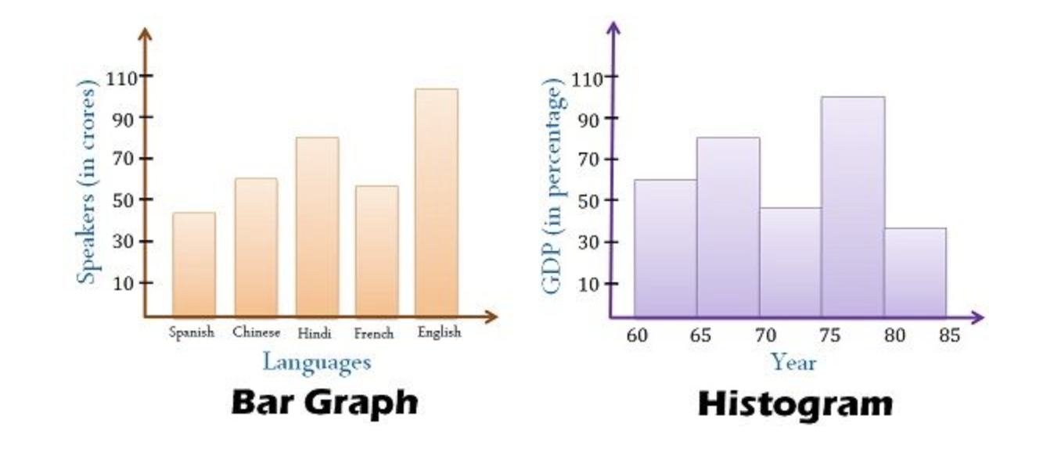
Bar plot Vs Histogram
The fundamental difference between histogram and bar graph will help you to identify the two easily is that there are gaps between bars in a bar graph but in the histogram, the bars are adjacent to each other.

Slide 24
What is Central Tendency?
Whenever you measure things of the same kind, a fairly large number of such measurements will tend to cluster around the middle value. Such a value is called a measure of "Central Tendency". The other terms that are used synonymously are "Measures of Location", or "Statistical Averages".

Slide 25
Arithmetic Mean
The inner diameter of a particular grade of tire based on 5 sample measurements are as follows: (figures in millimeters)
565, 570, 572, 568, 585
We get mean = (565+570+572+568+585)/5 =572
Caution: Arithmetic Mean is affected by extreme values or fluctuations in sampling. It is not the best average to use when the data set contains extreme values (Very high or very low values).

Slide 26
Median
Median is the middle most observation when you arrange data in ascending order of magnitude. Median is such that 50% of the observations are above the median and 50% of the observations are below the median.
Median is a very useful measure for ranked data in the context of consumer preferences and rating. It is not affected by extreme values (greater resistance to outliers)
Median = (n +1)/2
n = Number of observations in the sample

Slide 27
Median-Example
Marks obtained by 7 students in Computer Science Exam are given below: Compute the median.
45 40 60 80 90 65 55
Arranging the data after ranking gives
90 80 65 60 55 45 40
Median=(n+1)/2
=(7+1)/2
=4th Observation
Median=60

Slide 28
Mode
Mode is that value which occurs most often. It has the maximum frequency of occurrence. Mode also has resistance to outliers.
Mode is a very useful measure when you want to keep in the inventory, the most popular shirt in terms of collar size during festive season.

Slide 29
Mode -Example
The life in number of hours of 10 flashlight batteries are as follows: Find the mode.
340 340 350 350 340 340 320 340 330 330
340 occurs five times.
Hence, mode=340.

Slide 30
Mean, Median, Mode
Mean | Median | Mode
Defined as the arithmetic average of all observations in the data set. Requires measurement on all observations. Uniquely and comprehensively defined. | Defined as the middle value in the data set arranged in ascending or descending order. Does not require measurement on all observations Cannot be uniquely determined under all conditions. | Defined as the most frequently occurring value in the distribution; it has the largest frequency. Does not require measurement on all observations Not uniquely defined for multi-modal situations.

Slide 31
Comparison of Mean, Median, Mode Cont.
Mean | Median | Mode
Affected by extreme values. Can be treated algebraically. That is, Means of several groups can be combined. | Not affected by extreme values. Cannot be treated algebraically. That is, Medians of several groups cannot be combined. | Not affected by extreme values. Cannot be treated algebraically. That is, Modes of several groups cannot be combined.

Slide 32
Measures of Dispersion
In simple terms, measures of dispersion indicate how large the spread of the distribution is around the central tendency. It answers unambiguously the question " What is the magnitude of departure from the average value for different groups having identical averages?".

Slide 33
Range
Range is the simplest of all measures of dispersion. It is calculated as the difference between maximum and minimum value in the data set.
Range =X_{Maximum} −X _{Minimum}

Slide 34
Range-Example
Example for Computing Range. The following data represent the percentage return on investment for 10 mutual funds per annum. Calculate Range.
12, 14, 11, 18, 10.5, 11.3, 12, 14, 11, 9
Range=18-9=9
Caution: If one of the components of range namely the maximum value or minimum value becomes an extreme value, then range should not be used.

Slide 35
Inter-Quartile Range(IQR)
IQR= Range computed on middle 50% of the observations after eliminating the highest and lowest 25% of observations in a data set that is arranged in ascending order. IQR is less affected by outliers.
IQR =Q3 -Q1

Slide 36
Interquartile Range-Example
The following data represent the annual percentage returns of 9 mutual funds.
Data Set: [1,2,3,4,5,6,7,8,9,9,10]
Arranging in ascending order, the data set becomes
1,2,3,4,5,6,7,8,9,9,10
IQR=Q3-Q1=???

Slide 37
Percentile
Example

Slide 38
Percentile
25 Percentile=(25/100) * (n+1)
75 Percentile=(75/100) * (n+1)
IQR=Q3-Q1
Lower Bracket=Q1-1.5(IQR)
Upper Bracket=Q3+1.5(IQR)

Slide 39
Percentiles
Percentile rank of x= (Number of values below x/x)*100
Value=(Percentile/100)*(n+1)

Slide 40
Standard Deviation
To define standard deviation, you need to define another term called variance. In simple terms, standard deviation is the square root of variance.
Example for Standard Deviation
The following data represent the percentage return on investment for 10 mutual funds per annum. Calculate the sample standard deviation.
12, 14, 11, 18, 10.5, 11.3, 12, 14, 11, 9

Slide 41
Example for Standard Deviation
The following data represent the percentage return on investment for 10 mutual funds per annum. Calculate the sample standard deviation.
12, 14, 11, 18, 10.5, 11.3, 12, 14, 11, 9
Variance=6.33
Standard Deviation=2.52

Slide 42
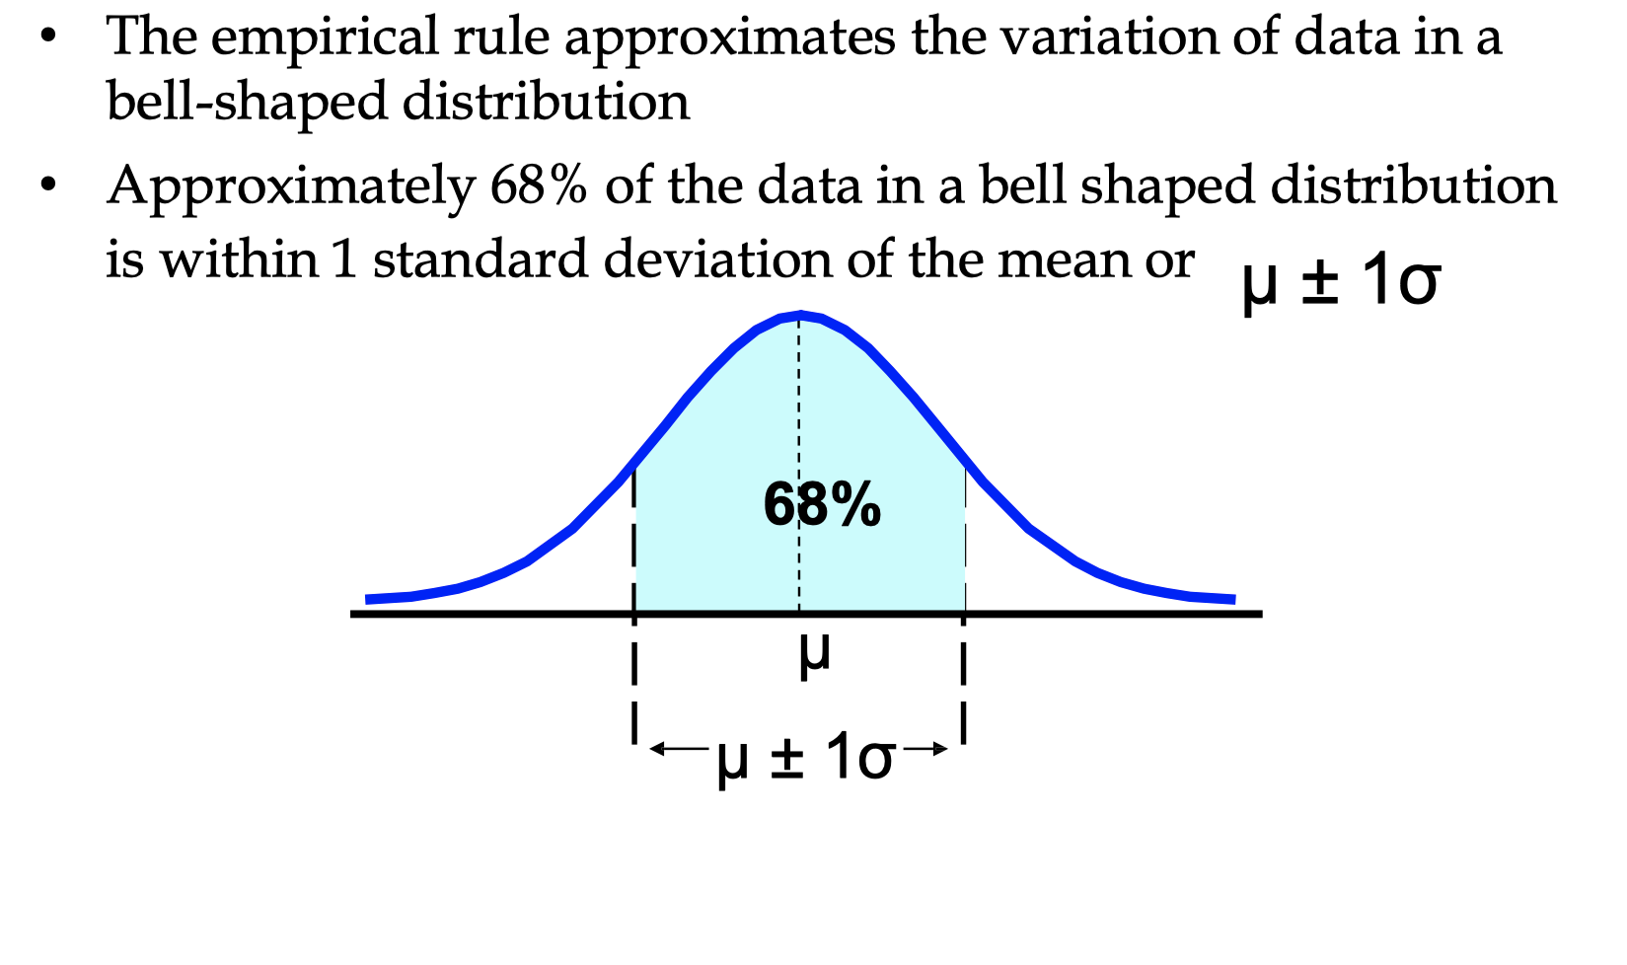
Empirical Rule

Slide 43
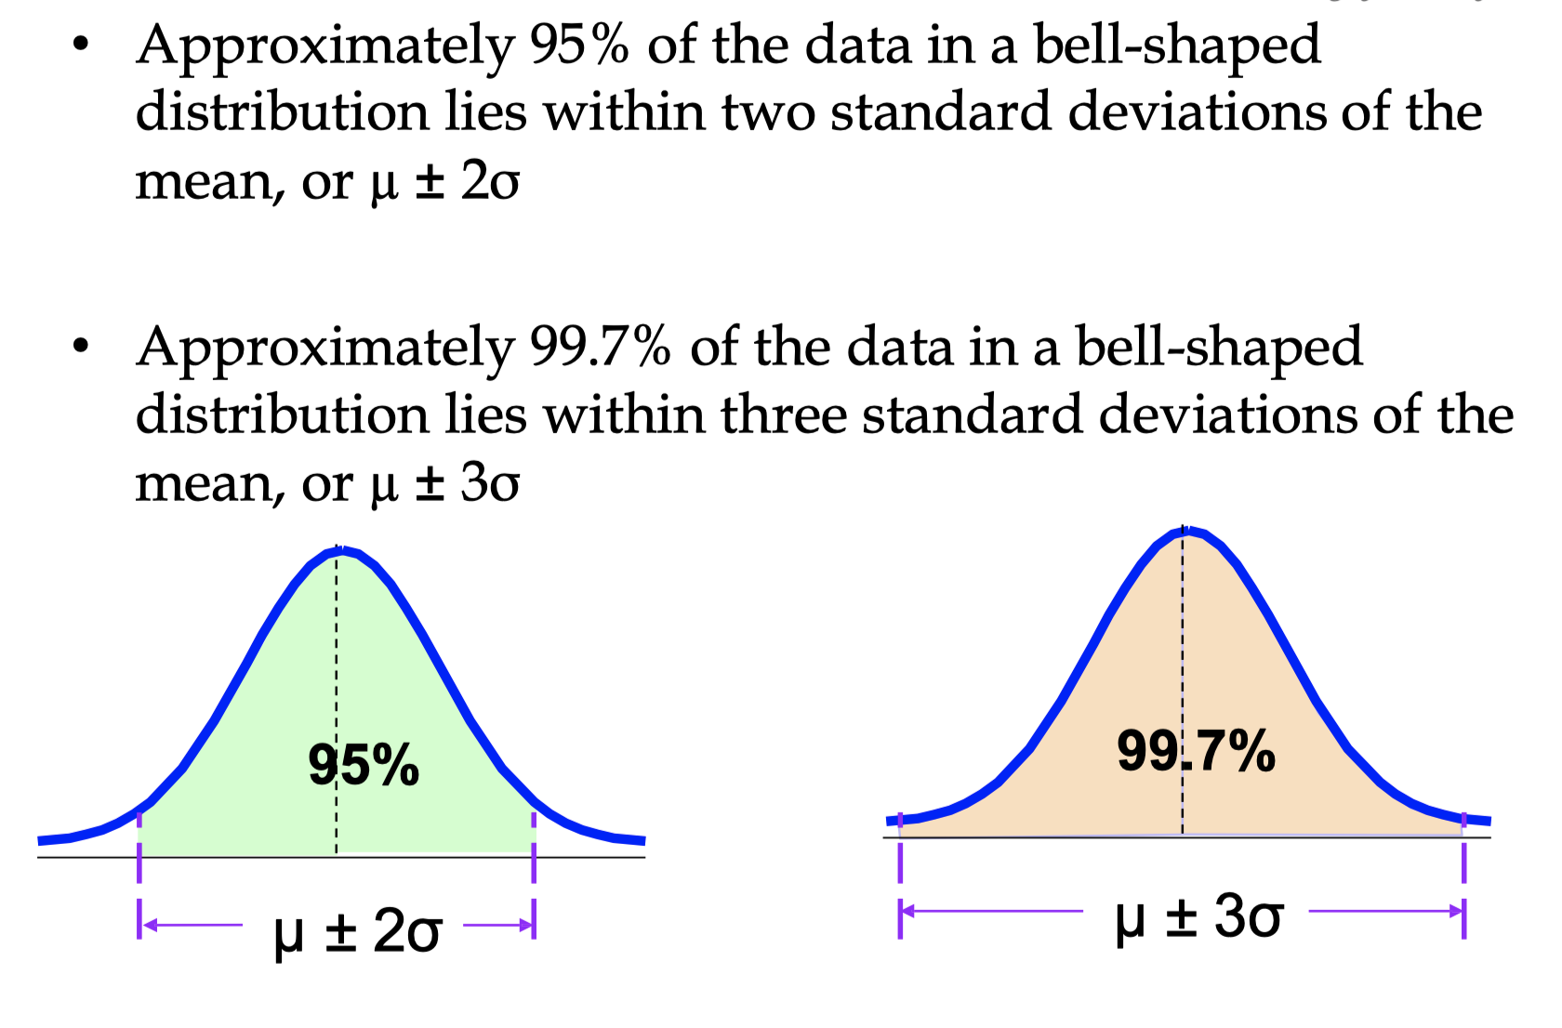
The Empirical Rule

Slide 44
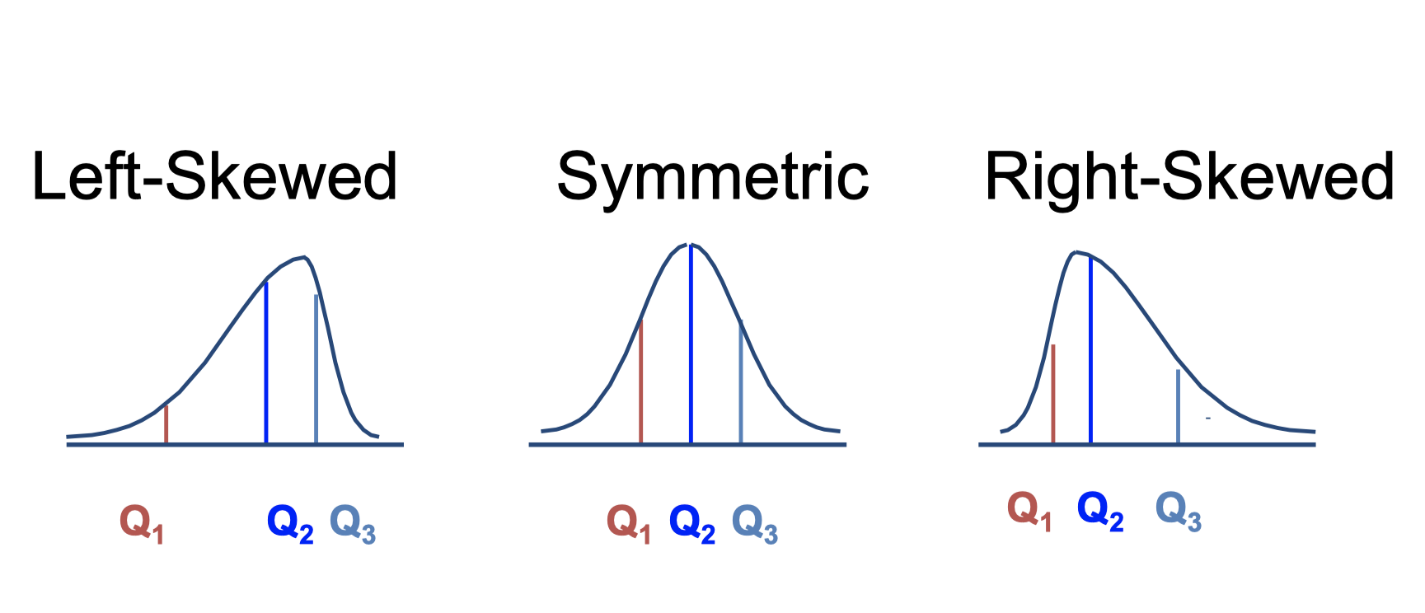
Distribution Shape

Slide 45
The Five Number Summary
The five numbers that help describe the center, spread and shape of data are:
X _{smallest}
First Quartile (Q1 )
Median (Q2 )
Third Quartile (Q3 )
X_{largest}

Slide 46
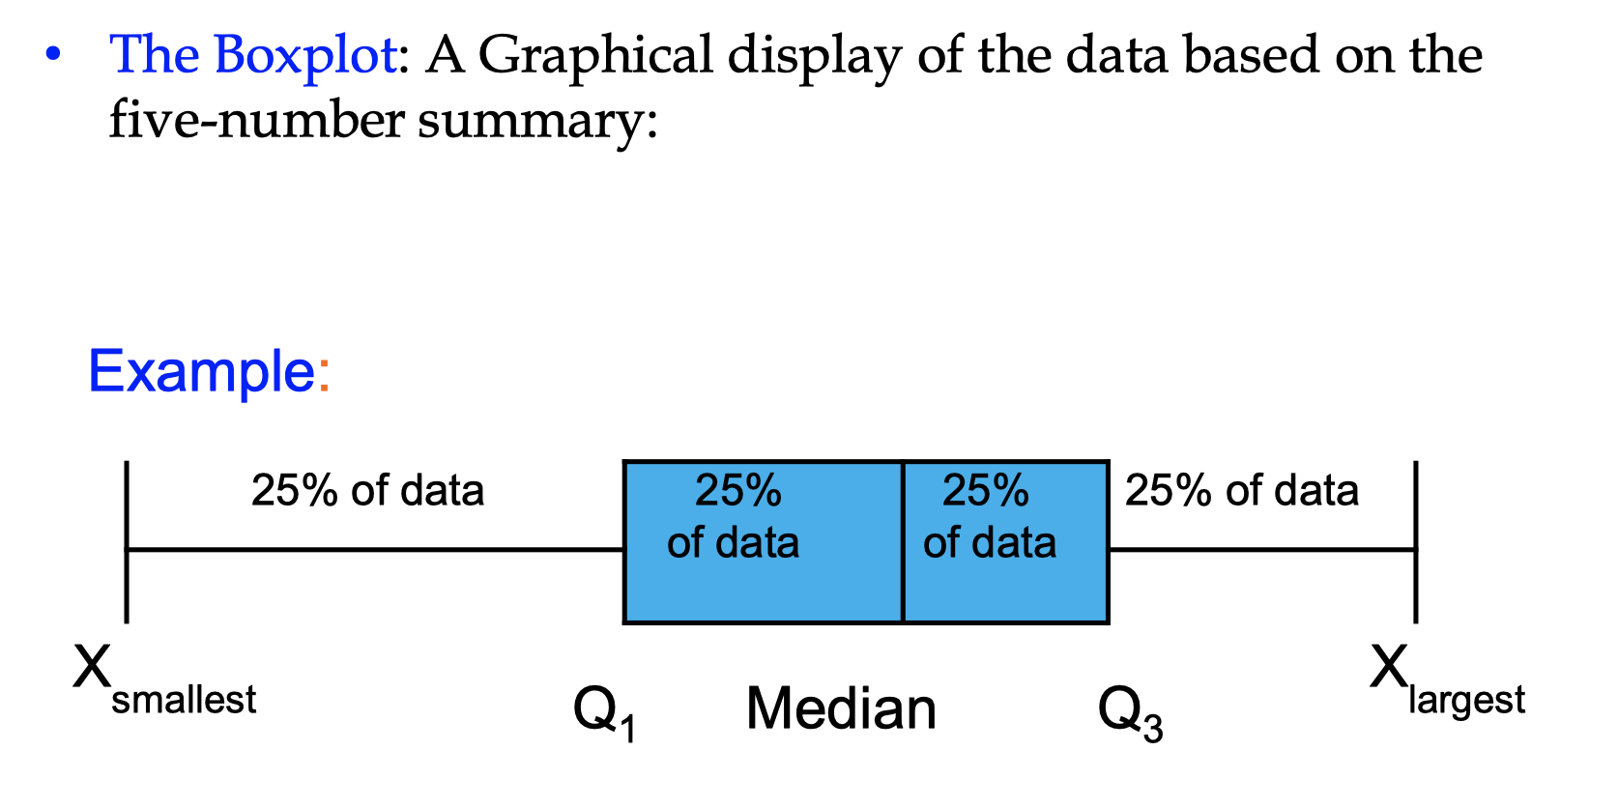
Five Number Summary and the Boxplot

Slide 47
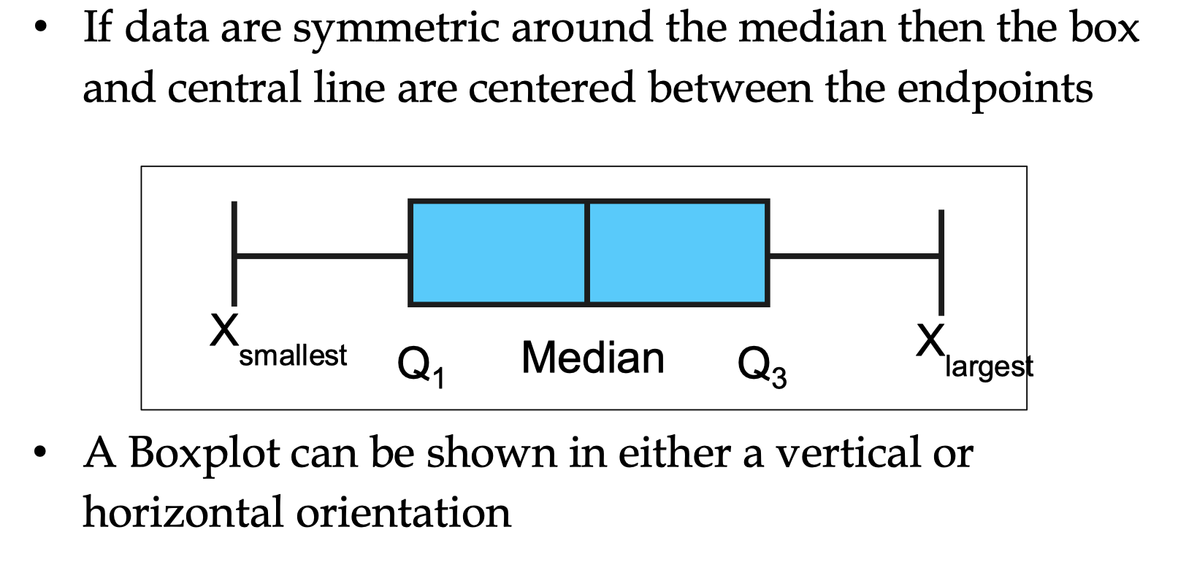
Five Number Summary and Shape of the Box Plots

Slide 48
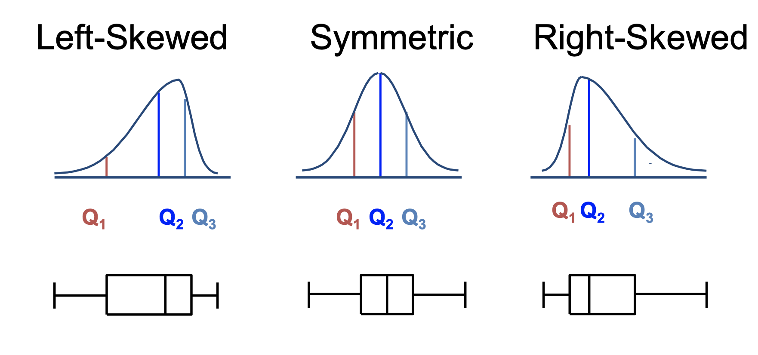
Distribution Shape and the Box Plot

Slide 49
Skewness
Skewness refers to a distortion or asymmetry that deviates from the symmetrical bell curve, or normal distribution, in a set of data. If the curve is shifted to the left or to. the right, it is said to be skewed.
Skewness is a descriptive statistic that can be used in conjunction with the histogram and the normal quantile plot to characterize the data or distribution. Skewness indicates the direction and relative magnitude of a distribution's deviation from the normal distribution.
Of the three measures of tendency, the mean is most heavily influenced by any outliers or skewness. In a symmetrical distribution, the mean, median, and mode are all equal. In these cases, the mean is often the preferred measure of central tendency.
Effects of skewness If there are too much skewness in the data, then many statistical model don't work but why. So in skewed data, the tail region may act as an outlier for the statistical model and we know that outliers adversely affect the model's performance especially regression-based models.

Slide 50
Skewness

Slide 51
Outlier
An outlier is a datapoint in a dataset which is distant from all other Observations
Ways of finding Outlier
Using Z-Score
Using IQR
Box Plot

Slide 52
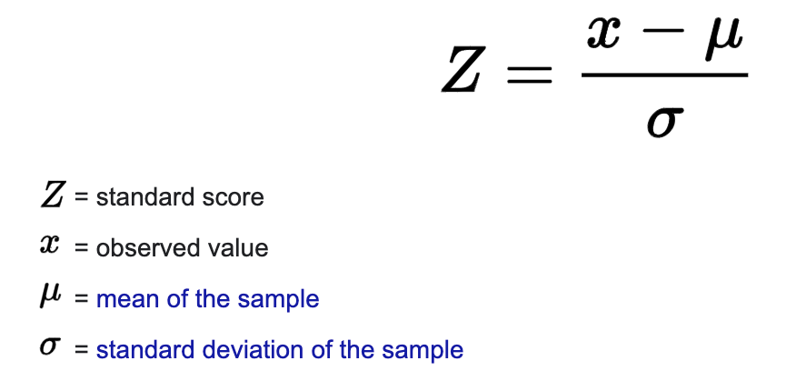
Z Score
z-score (also called a standard score) gives you an idea of how far from the mean a data point is. But more technically it’s a measure of how many standard deviations below or above the population mean a raw score is.
A z-score can be placed on a normal distribution curve. Z-scores range from -3 standard deviations (which would fall to the far left of the normal distribution curve) up to +3 standard deviations (which would fall to the far right of the normal distribution curve). In order to use a z-score, you need to know the mean μ and also the population standard deviation σ.

Slide 53
Z Score
How to interpret the results?
z-score = 0, the score (x) is exactly average;
z-score is positive, the score (x) is above average;
z-score is negative, the score (x) is below average.

Slide 54
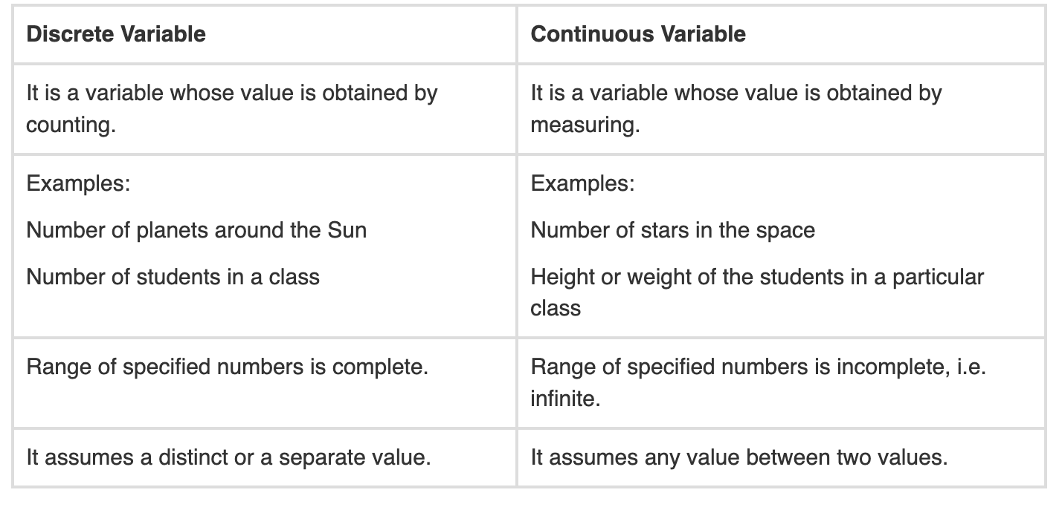
Discrete variable Vs Continuous Variable

